Slide 1
Database
Management System
Lecture - 38

Slide 2
Inverted Files
The attribute on which we want direct access, inverted file is created on that field
File is said to be inverted on that field
More than one inversions can be created, even on all attributes

Slide 3
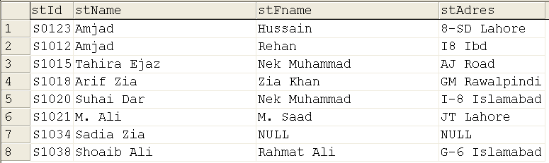
Amjad 1
Amjad 2
Arif Zia 4
M. Ali 6
Sadia Zia 7
Shoaib Ali 8
Suhail Dar 5
Tahira Ejaz 3
NULL 7
8-SD Lahore 1
AJ Road 3
G-6 Islamabad 8
GM Rawalpindi 4
I-8 Islamabad 5
I8 Ibd 2
JT Lahore 6
Inversion
On
stName
Inversion
On
stAdres

Slide 4
Inverted Files
Inverted file contains the values of attribute in sorted order and the relative address of the record
DBMS searches appropriate record no and hands over to access method to retrieve the desired record

Slide 5
Linked Lists
AKA Pointer Chain
Needs an extra field in the physical record to store the link
Relative addresses are used

Slide 6
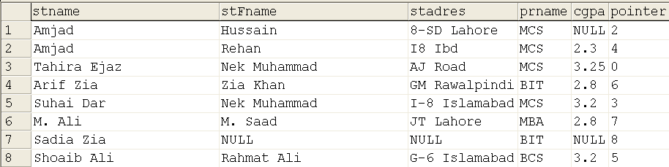

Slide 7
Linked Lists
Head pointer needs to be stored
Pointers for multiple fields can be created
Circular pointers
Double linked lists

Slide 8
Tree Index
Index is maintained in a hierarchical arrangements of nodes
Each node stores key values and pointers; nodes are connected through links

Slide 9
Tree Index
There is a special node called the root node
Each node has a parent node (but the root) and has one or more children (but the leaf nodes)
Different types of trees exist

Slide 10
B+ Trees
Number of pointers in a node is one more than the number of keys
Number of pointers called order of tree
Distance of all leaf nodes from the root is same

Slide 11
Example Tree Index
Index entries:<search key value, page id> they direct search for data entries in leaves.
Example where each node can hold 2 entries.

Slide 12
Example Tree Index
Root
40
Insert 25
20
33
51
63
10*
15*
20*
27*
33*
37*
40*
46*
51*
55*
63*
97*

Slide 13
Example Tree Index
Root
27
40
20
33
51
63
10*
15*
20*
25*
33*
37*
40*
46*
51*
55*
63*
97*
27*

Slide 14
Example Tree Index
Root
27
40
Insert 22
20
25
33
35
51
63
10*
15*
20*
23*
33*
34*
40*
46*
51*
55*
63*
97*
25*
26*
27*
32*
35*
37*

Slide 15
Root
33
Insert 29, 30
23
40
20
25
33
35
51
63
10*
15*
20*
22*
33*
34*
40*
46*
51*
55*
63*
97*
25*
26*
27*
32*
35*
37*
23*

Slide 16
Root
33
23
40
20
25
29
33
35
51
63
10*
15*
20*
22*
33*
34*
40*
46*
51*
55*
63*
97*
25*
26*
27*
32*
35*
37*
23*
29*
30*

Slide 17
Alternatives for Data Entry k* in Index
What is actually stored in the leaves of the index for key value “k”?

Slide 18
Three Alternatives
Actual data record(s) with key value k
{<k, rid of matching data record>}
<k, list of rids of matching data records>

Slide 19
Alternative 1
Actual data record (with key value k)
  If this is used, index structure is a file organization for data records (like Heap files or sorted files).

Slide 20
Alternative 1
At most one index on a given collection of data records can use Alternative 1.

Slide 21
Alternative 1
This alternative saves pointer lookups but can be expensive to maintain with insertions and deletions.

Slide 22
Alternative 2 & 3
Alternative 2
{<k, rid of matching data record>}
Alternative 3
<k, list of rids of matching data records>

Slide 23
Alternative 2 & 3
Easier to maintain than Alt 1.
If more than one index is required on a given file, at most one index can use Alternative 1
Rest must use Alternatives 2 or 3.

Slide 24
Alternative 2 & 3
Alternative 3 more compact than Alternative 2, but leads to variable sized data entries even if search keys are of fixed length.

Slide 25
Alternative 2 & 3
Even worse, for large rid lists the data entry would have to span multiple blocks!

Slide 26
Database
Management System
Lecture - 38

